Slide 1
Unit 2 Numerical Representations
EL-GY 9463: Introduction to Hardware Design
ProfS. Sundeep Rangan, Siddharth Garg

Slide 2
Today’s Lecture
The world is continuous and infinite, but computers are finite
How do we represent numeric values in a finite numbers of bits?
More generally, how can values be compressed?
What representations are computationally simple?
What representations result in good approximations to reality?

Slide 3
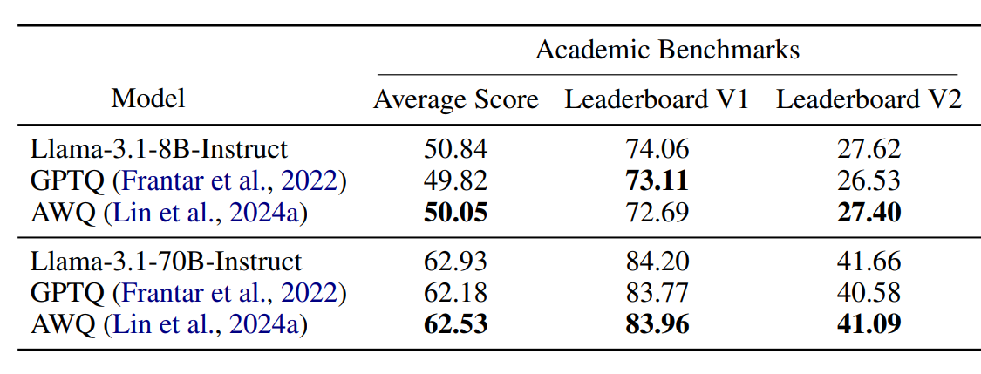
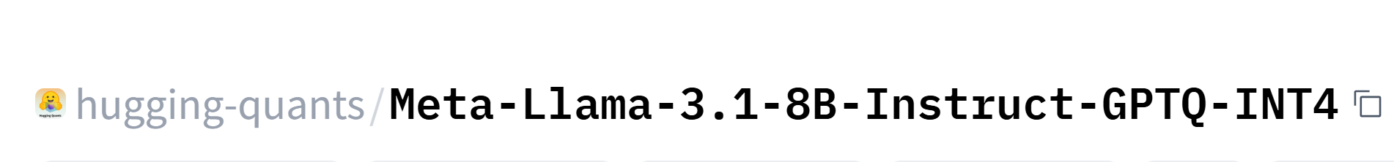
Example 1: Embedded LLMs
Full LLMs require massive amounts of memory
Cannot work on embedded devices
Quantization
Aggressive reduction in number of bits / parameter
Ex: INT4 vs. FP32
New techniques have enabled very low footprint
Often 1 to 1.5 GB
Performance often remains excellent
With judicious choice of approximation techniques
Kurtic, Eldar, et al. "“Give Me BF16 or Give Me Death”? Accuracy-Performance Trade-Offs in LLM Quantization." Proceedings of the 63rd Annual Meeting of the Association for Computational Linguistics (Volume 1: Long Papers). 2025.

Slide 4
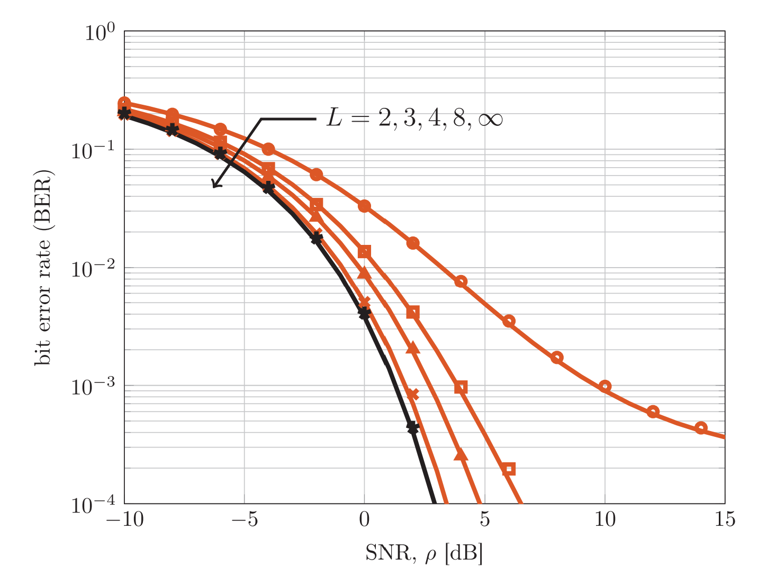
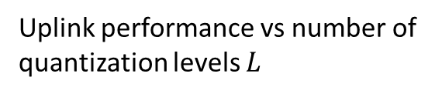
Example 2: Next-Generation Wireless
Massive MIMO systems in cellular base stations
100s – 1000s of antennas
Each antenna gets data at ~1 Gsamp/s
Data rate and processing is overwhelming
Very low-rate quantization has been key
2- 4 bits per antenna
Uplink performance vs number of quantization levels $L$
Jacobsson, S., Durisi, G., Coldrey, M., Gustavsson, U., & Studer, C. (2017). Throughput analysis of massive MIMO uplink with low-resolution ADCs. IEEE Transactions on Wireless Communications, 16(6), 4038-4051.

Slide 5

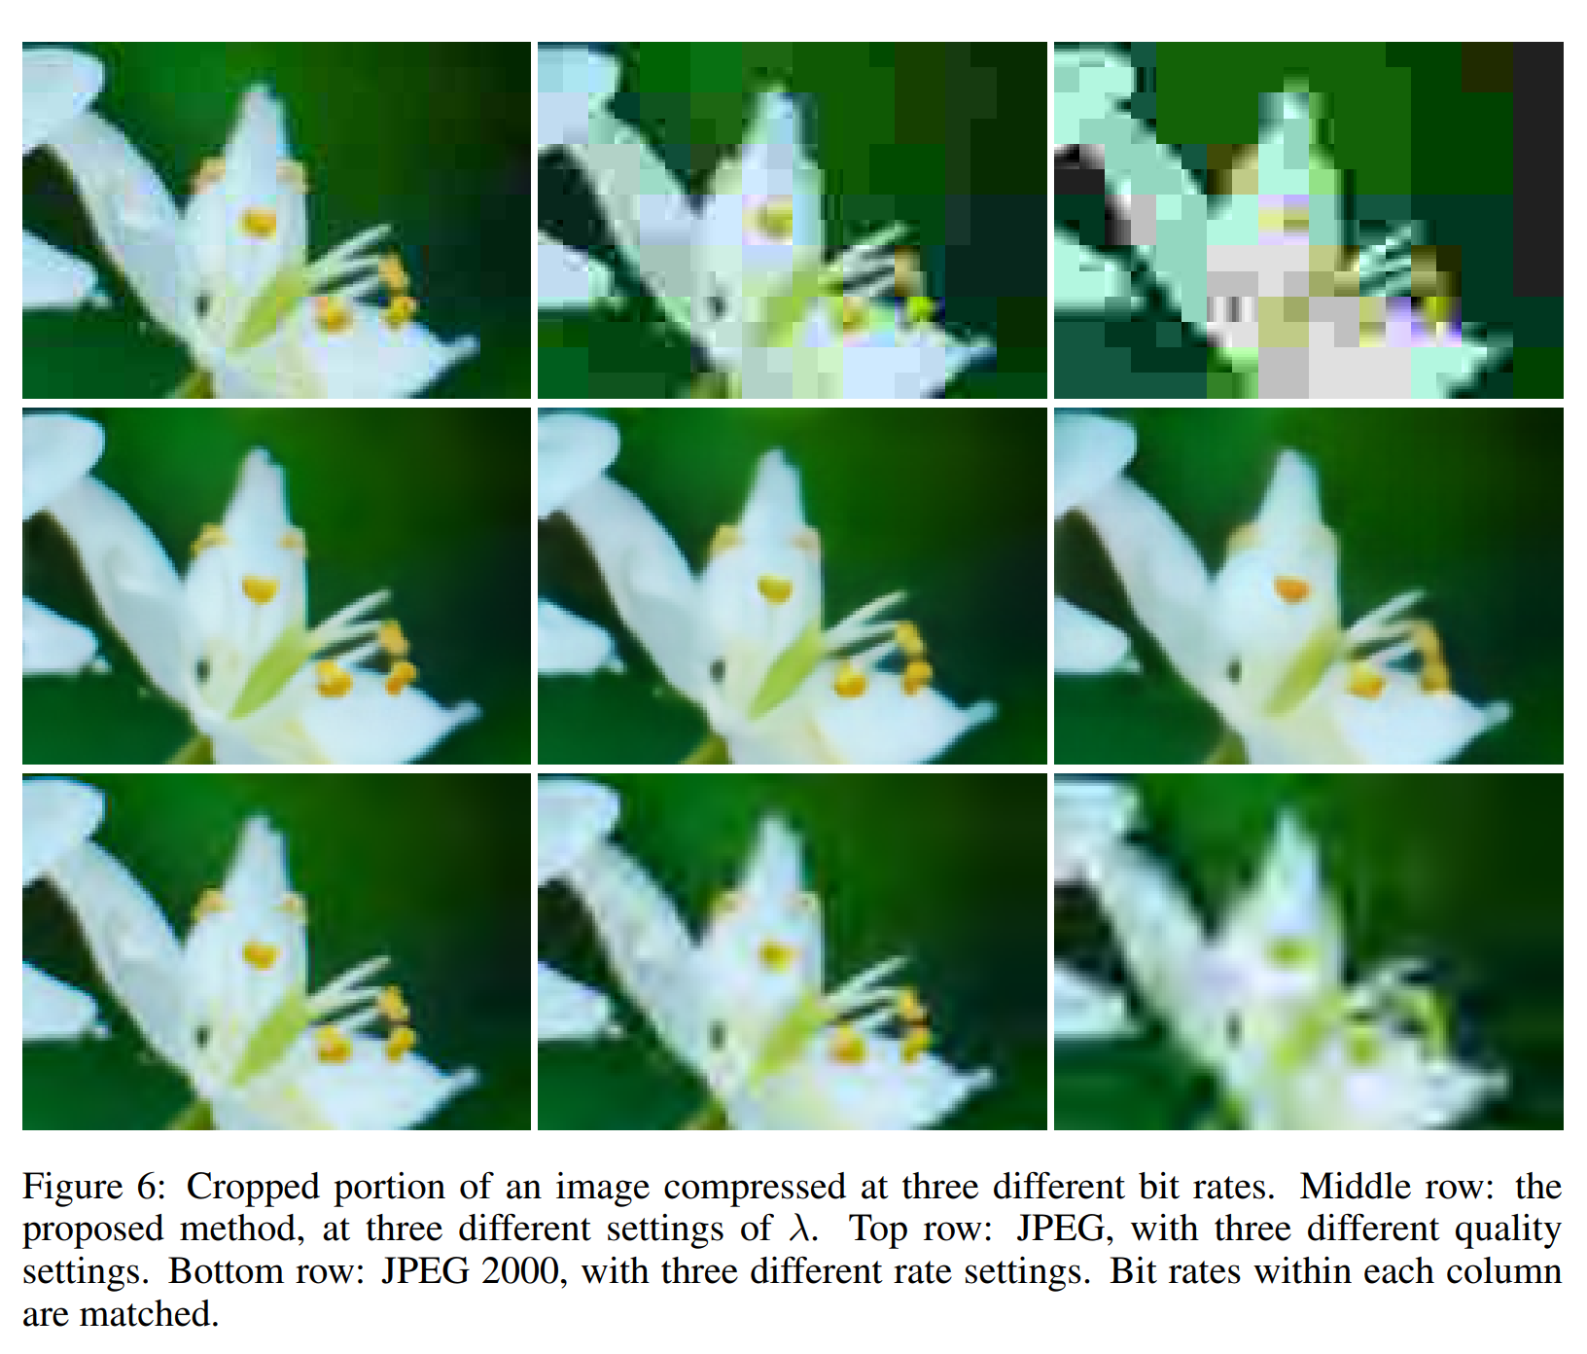
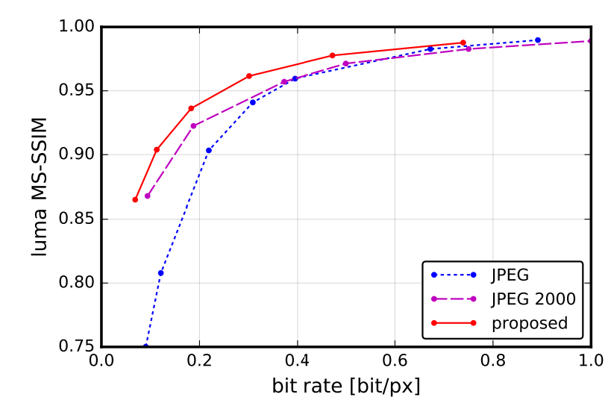
Compression Research at NYU
Ballé, J., Laparra, V., & Simoncelli, E. P. (2016). End-to-end optimized image compression. arXiv preprint arXiv:1611.01704.
ML techniques at the forefront for learning new compression
NYU has several leading researchers in the area
Jona Balle, NYU

Slide 6
Learning Objectives
Represent numbers in various formats: Integers, floating point, fixed point
Implement arithmetic operations efficiently in these format
Identify cases for overflow
Evaluate approximation errors via simulation
Optimally select scaling factors and parameters for the formats
Convert floating point algorithms to fixed point

Slide 7
Outline
Integers, Truncation, and Overflows
Floating Point Numbers
Fixed Point Numbers
Optimal Scaling of FixP Numbers
Converting Floating Point Algorithms to Fixed Point

Slide 8
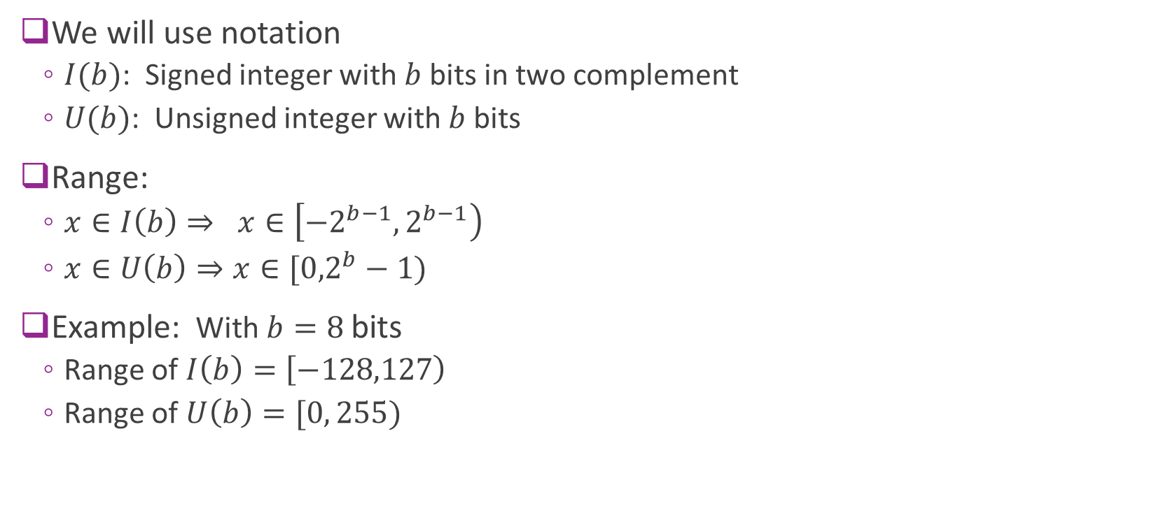
Integers
We will use notation
$I(b)$: Signed integer with $b$ bits in two complement
$U(b)$: Unsigned integer with $b$ bits
Range:
$x∈I\left(b\right)⇒ x∈\left[−2^{b−1},2^{b−1}\right)$
$x∈U\left(b\right)⇒x∈[{0,2}^{b}−1)$
Example: With $b=8$bits
Range of $I\left(b\right)=\left[−128,127\right)$
Range of $U\left(b\right)=[0, 255)$

Slide 9
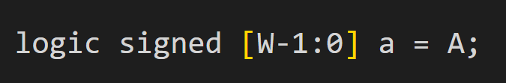
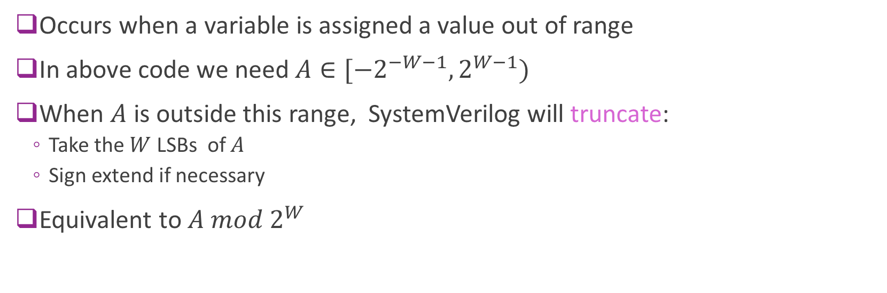
Truncation
Occurs when a variable is assigned a value out of range
In above code we need $A∈[{−2}^{−W−1},2^{W−1})$
When $A$ is outside this range, SystemVerilog will truncate:
Take the $W$ LSBs of $A$
Sign extend if necessary
Equivalent to $A mod 2^{W}$

Slide 10
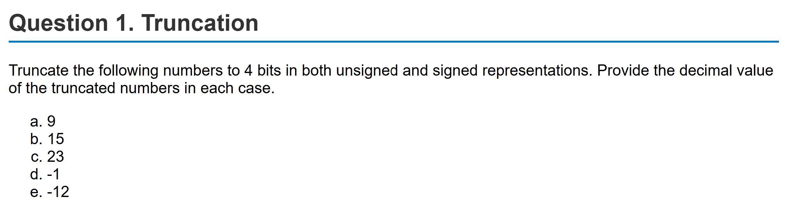
Sample Problem
Can see problem on LLM auto grader

Slide 11
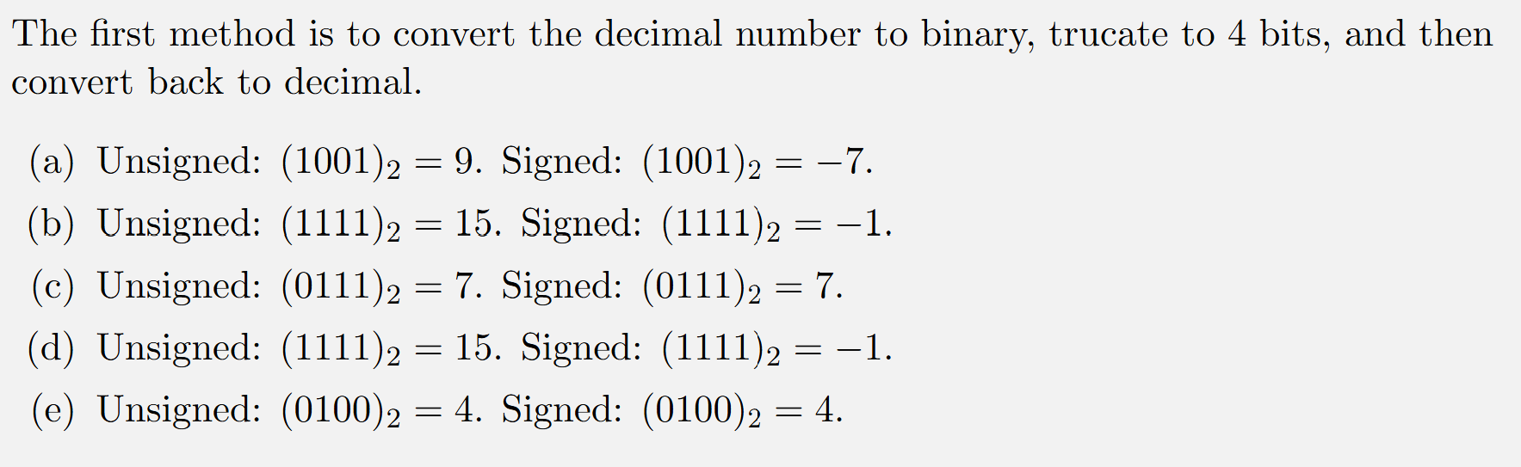
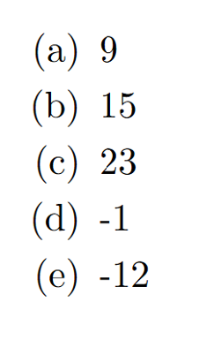
Solution using Binary Representations

Slide 12
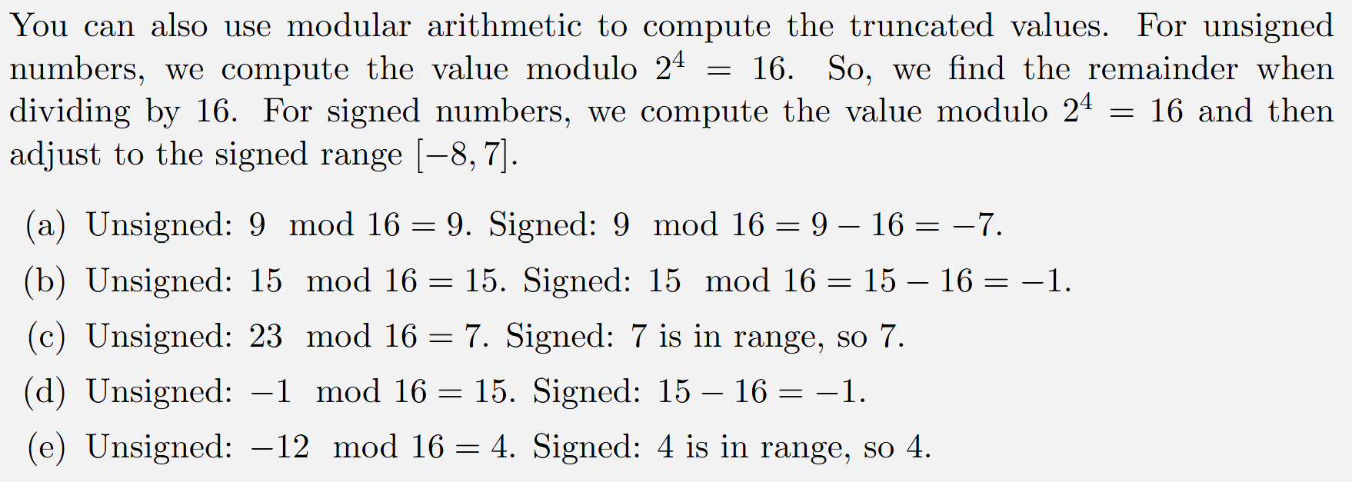
Solution using Modulo Arithmetic

Slide 13
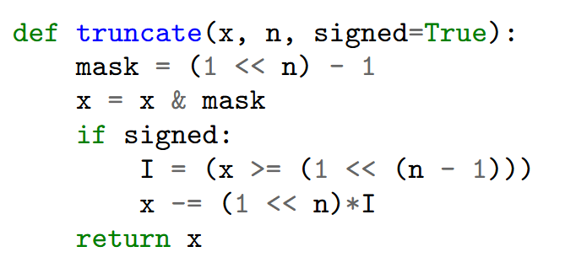
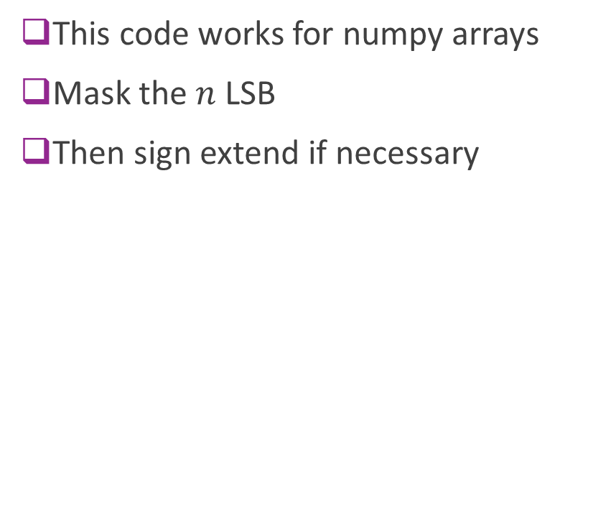
Simulating Truncation in Python
This code works for numpy arrays
Mask the $n$ LSB
Then sign extend if necessary

Slide 14
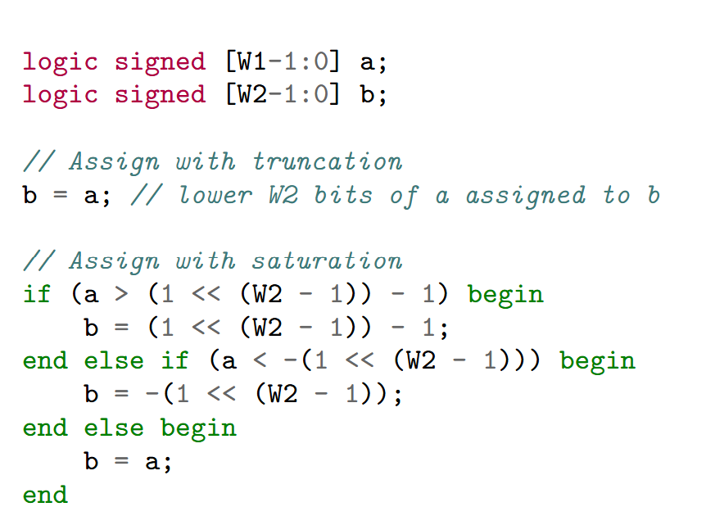
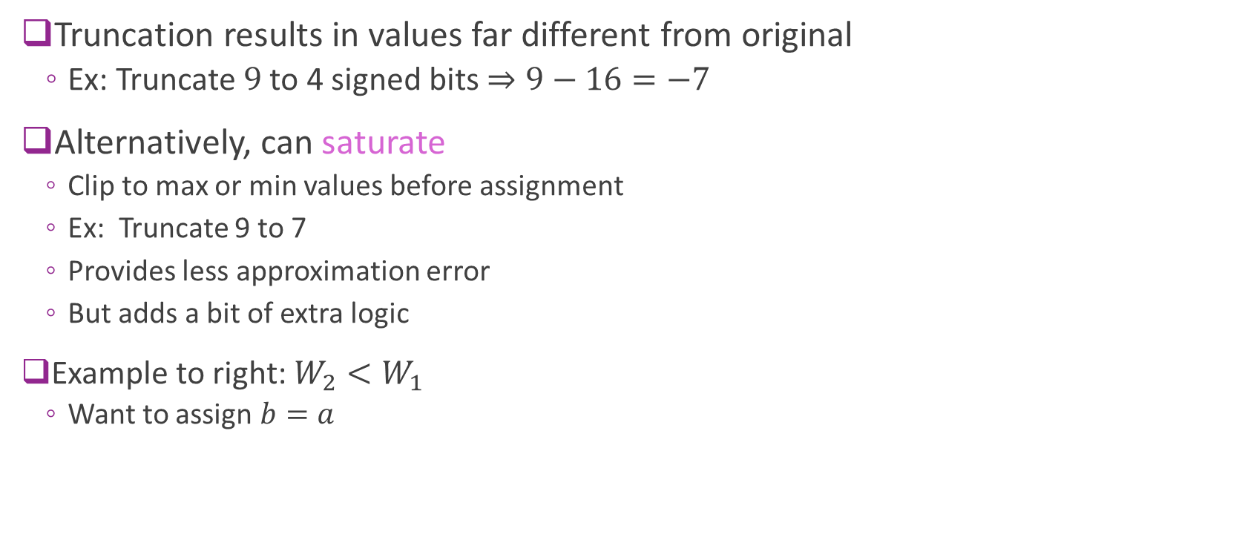
Saturation
Truncation results in values far different from original
Ex: Truncate $9$ to 4 signed bits $⇒9−16=−7$
Alternatively, can saturate
Clip to max or min values before assignment
Ex: Truncate 9 to 7
Provides less approximation error
But adds a bit of extra logic
Example to right: $W_{2}<W_{1}$
Want to assign $b=a$

Slide 15
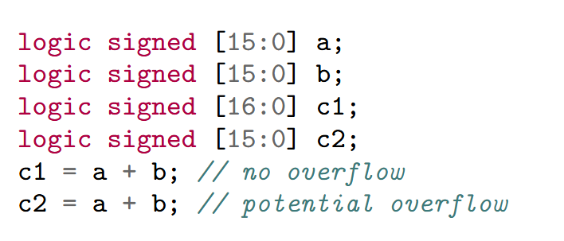
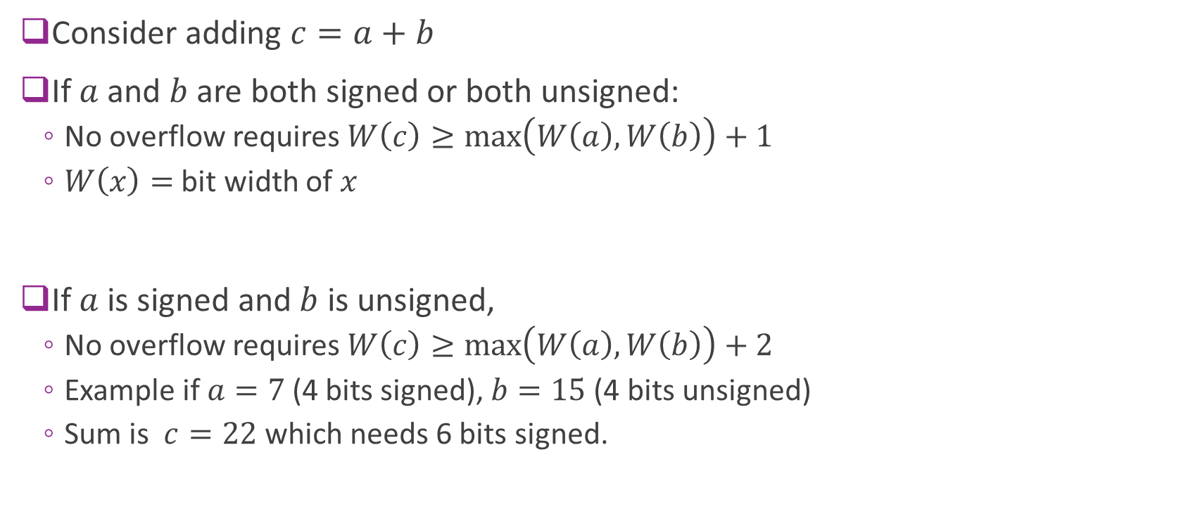
Addition Overflow Rules
Consider adding $c=a+b$
If $a$ and $b$ are both signed or both unsigned:
No overflow requires $W\left(c\right)≥\max\left(W\left(a\right),W\left(b\right)\right)+1$
$W\left(x\right)=$ bit width of $x$
If $a$ is signed and $b$ is unsigned,
No overflow requires $W\left(c\right)≥\max\left(W\left(a\right),W\left(b\right)\right)+2$
Example if $a=7$ (4 bits signed), $b=15$ (4 bits unsigned)
Sum is $c=22$ which needs 6 bits signed.

Slide 16
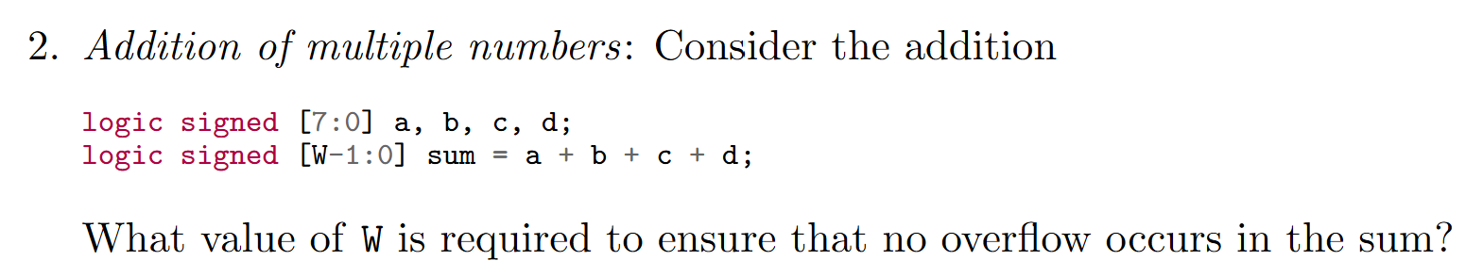
Sample Problem
See solution in the autograder

Slide 17
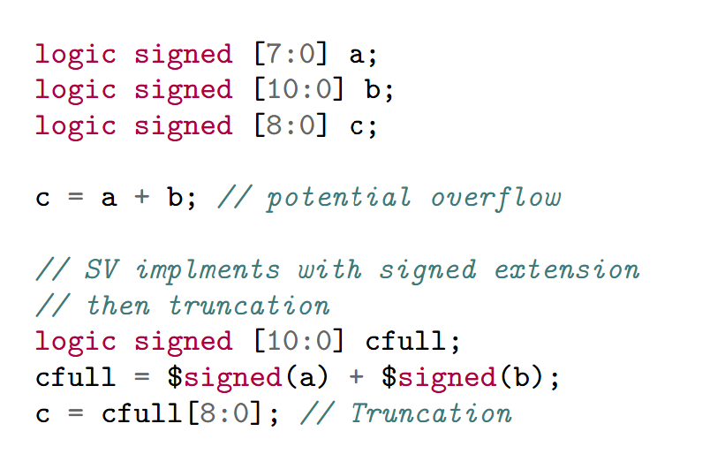
Addition with Truncation
Given a potential overflow, SV will:
Create a temporary variable with no overflow
Temporary variable has enough bits
Then it will truncate to lower bits
Saturation must be implemented manually

Slide 18
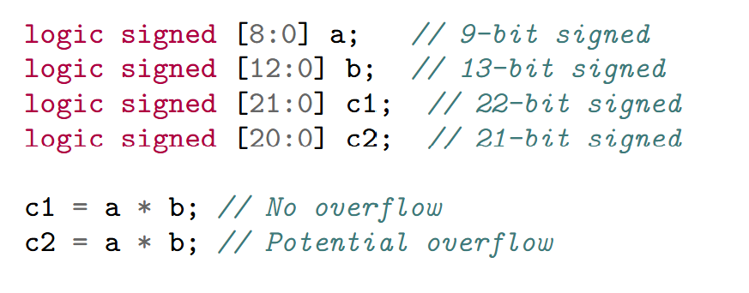
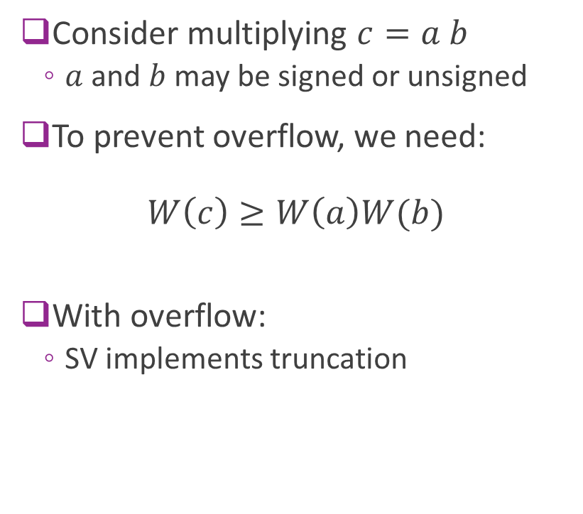
Multiplication Overflow
Consider multiplying $c=a b$
$a$ and $b$ may be signed or unsigned
To prevent overflow, we need: $W\left(c\right)≥W\left(a\right)W(b)$
With overflow:
SV implements truncation

Slide 19
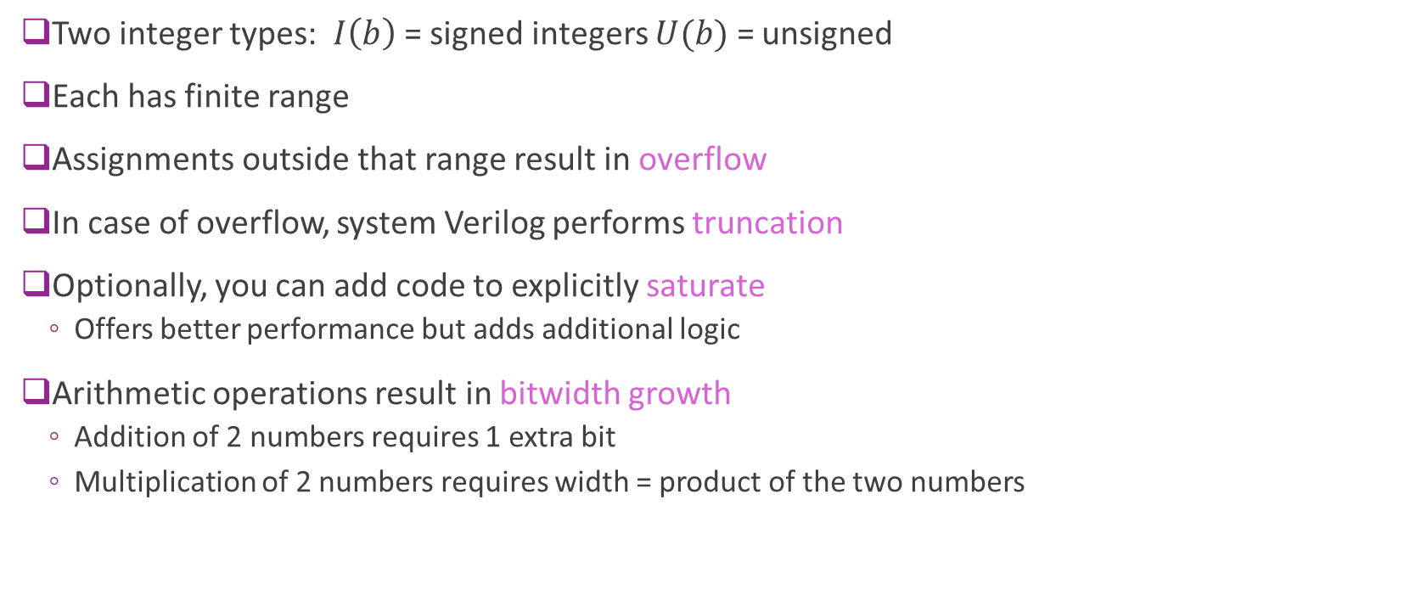
Summary
Two integer types: $I\left(b\right)$ = signed integers $U(b)$ = unsigned
Each has finite range
Assignments outside that range result in overflow
In case of overflow, system Verilog performs truncation
Optionally, you can add code to explicitly saturate
Offers better performance but adds additional logic
Arithmetic operations result in bitwidth growth
Addition of 2 numbers requires 1 extra bit
Multiplication of 2 numbers requires width = product of the two numbers

Slide 20
Outline
Integers, Truncation, and Overflows
Floating Point Numbers
Fixed Point Numbers
Mapping Floating to Fixed Point in Python
System Verilog Implementation

Slide 21
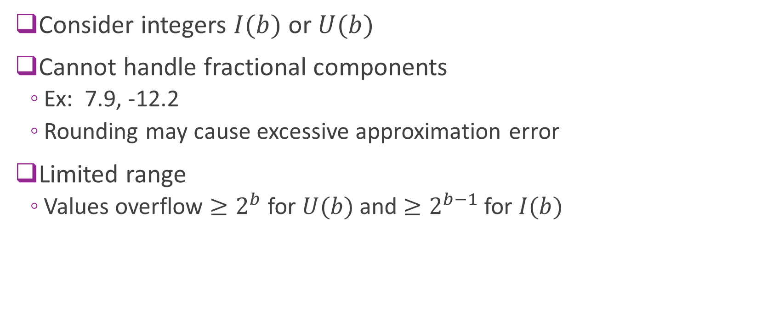
Limitations of Integers
Consider integers $I(b)$ or $U(b)$
Cannot handle fractional components
Ex: 7.9, -12.2
Rounding may cause excessive approximation error
Limited range
Values overflow $≥2^{b}$ for $U(b)$ and $≥2^{b−1}$ for $I(b)$

Slide 22
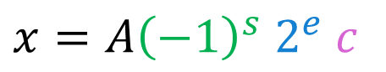
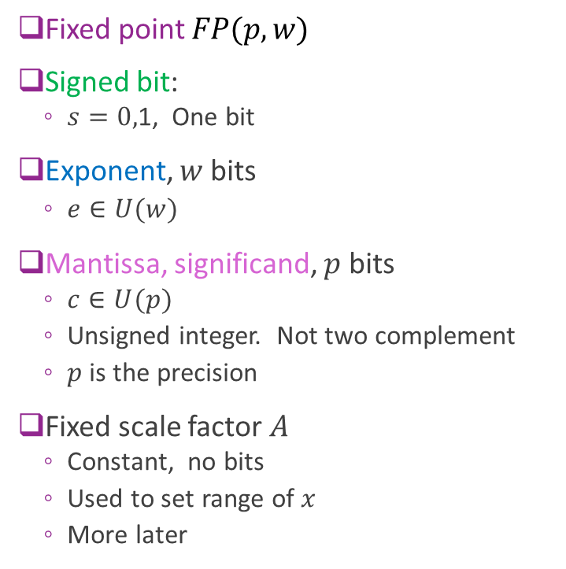
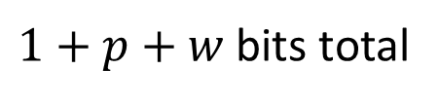
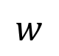
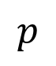
Simple Floating Point
Fixed point $FP(p,w)$
Signed bit:
$s=0,$1, One bit
Exponent, $w$ bits
$e∈U(w)$
Mantissa, significand, $p$ bits
$c∈U(p)$
Unsigned integer. Not two complement
$p$ is the precision
Fixed scale factor $A$
Constant, no bits
Used to set range of $x$
More later
$x=A{\left(−1\right)}^{s} 2^{e}$ $c$
Bits=
1
$$w$$
$$p$$
$1+p+w$ bits total

Slide 23
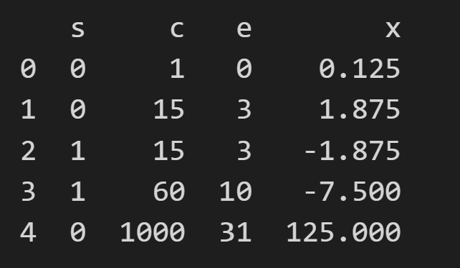
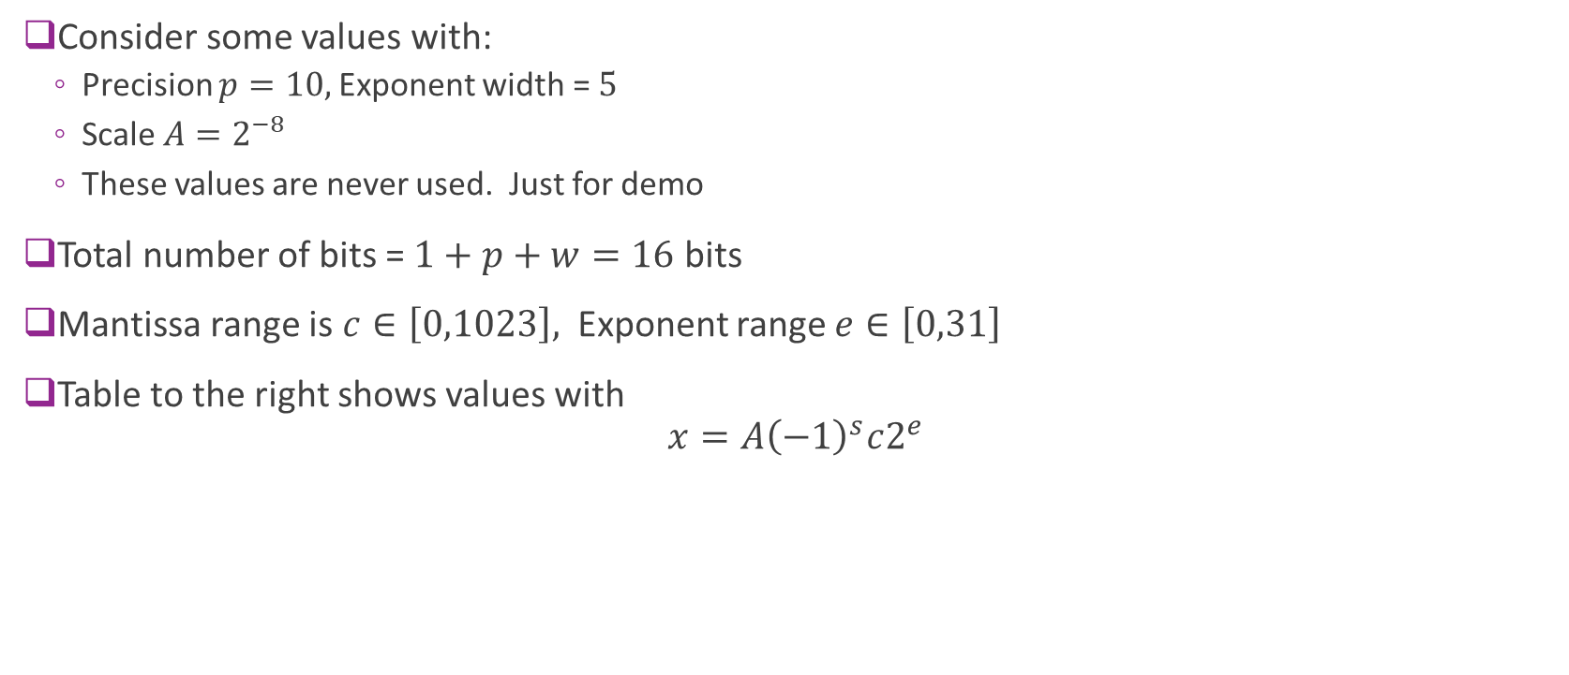
Example
Consider some values with:
Precision $p=10,$Exponent width = $5$
Scale $A=2^{−8}$
These values are never used. Just for demo
Total number of bits = $1+p+w=16$ bits
Mantissa range is $c∈\left[0,1023\right],$ Exponent range $e∈\left[0,31\right]$
Table to the right shows values with $x=A{\left(−1\right)}^{s}c2^{e}$

Slide 24
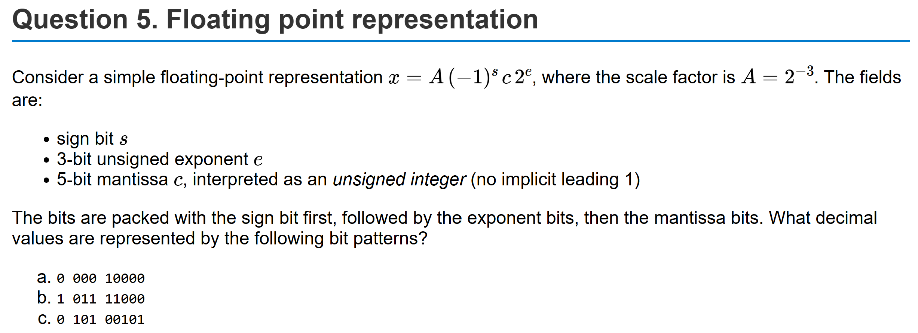
Example Problem

Slide 25
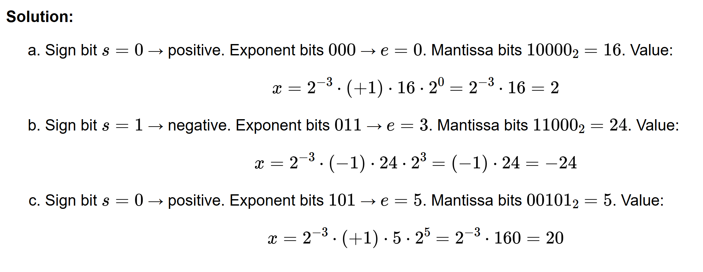
Solution

Slide 26
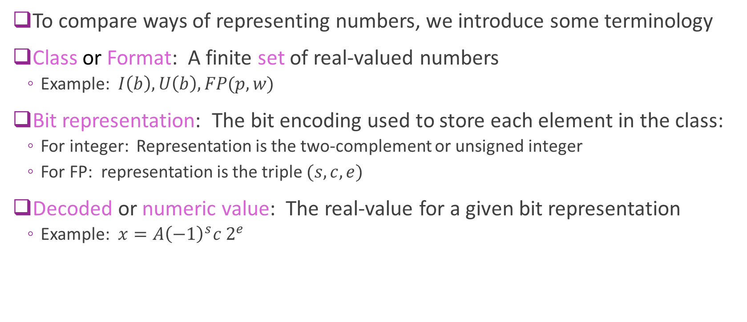
Terminology
To compare ways of representing numbers, we introduce some terminology
Class or Format: A finite set of real-valued numbers
Example: $I\left(b\right), U\left(b\right), FP(p,w)$
Bit representation: The bit encoding used to store each element in the class:
For integer: Representation is the two-complement or unsigned integer
For FP: representation is the triple $(s, c, e)$
Decoded or numeric value: The real-value for a given bit representation
Example: $x=A{\left(−1\right)}^{s}c 2^{e}$

Slide 27
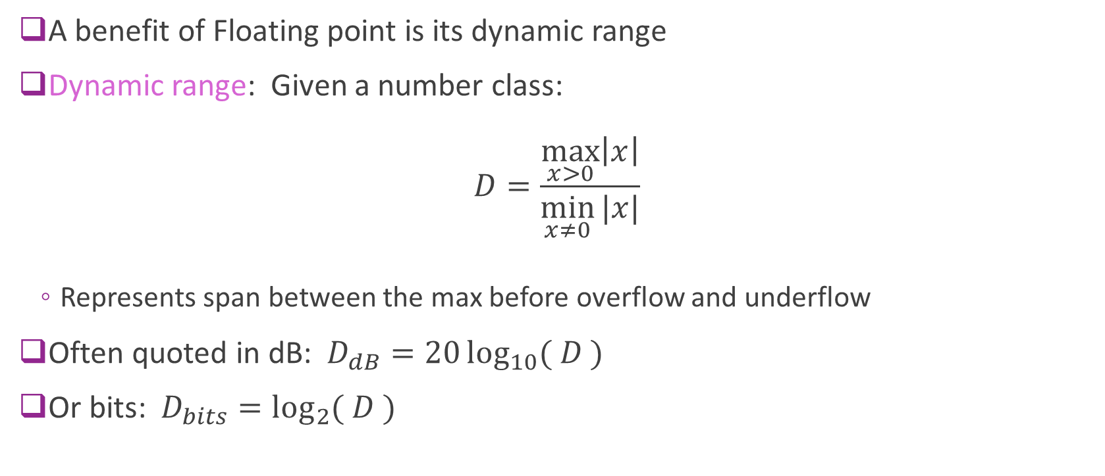
Dynamic Range
A benefit of Floating point is its dynamic range
Dynamic range: Given a number class: $D=\frac{\max_{x>0}\left|x\right|}{\min_{x≠0}{|x|}}$
Represents span between the max before overflow and underflow
Often quoted in dB: $D_{dB}=20\log_{10}{( D )}$
Or bits: $D_{bits}=\log_{2}{( D )}$

Slide 28
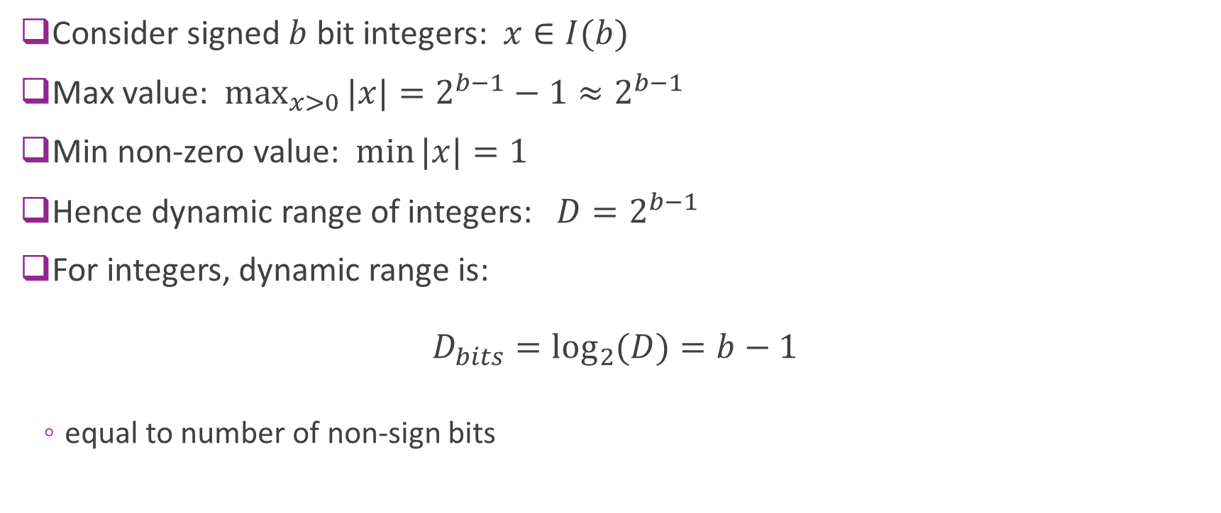
Dynamic Range of Integers
Consider signed $b$ bit integers: $x∈I(b)$
Max value: $\max_{x>0}{|x|}=2^{b−1}−1≈2^{b−1}$
Min non-zero value: $\min{|x|}=1$
Hence dynamic range of integers: $D=2^{b−1}$
For integers, dynamic range is: $D_{bits}=\log_{2}{(D)}=b−1$
equal to number of non-sign bits

Slide 29
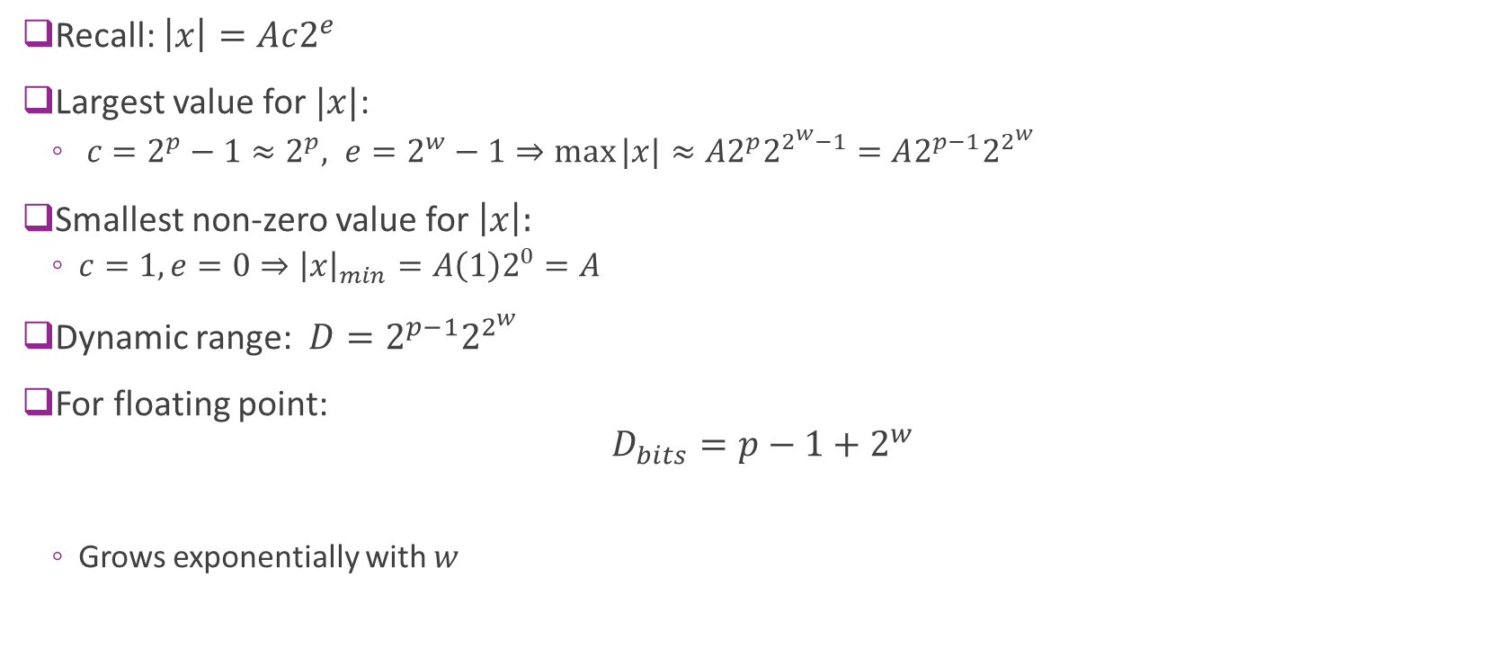
Floating-Point Dynamic Range
Recall: $\left|x\right|=Ac2^{e}$
Largest value for $|x|$:
$c=2^{p}−1≈2^{p}, e=2^{w}−1⇒\max{|x|}≈A2^{p}2^{2^{w}−1}=A2^{p−1}2^{2^{w}}$
Smallest non-zero value for $\left|x\right|:$
$c=1, e=0⇒{\left|x\right|}_{min}=A\left(1\right)2^{0}=A$
Dynamic range: $D=2^{p−1}2^{2^{w}}$
For floating point: $D_{bits}=p−1+2^{w}$
Grows exponentially with $w$

Slide 30
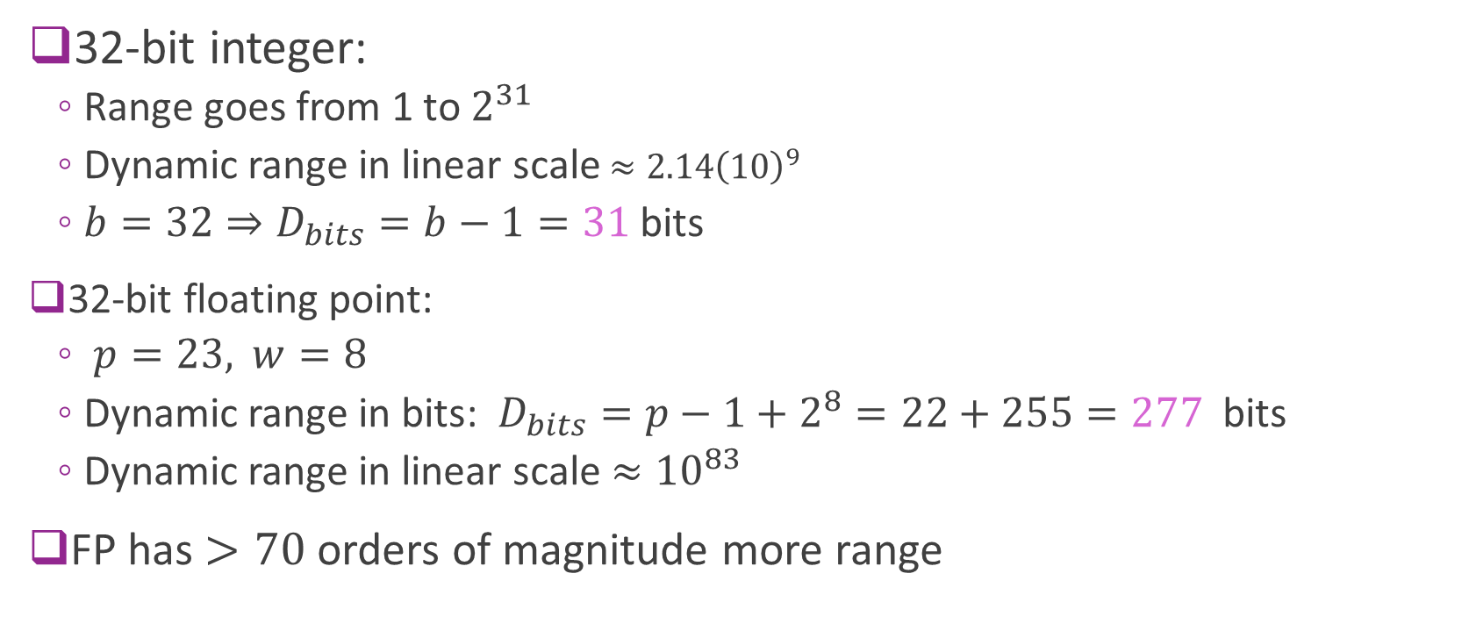
Example Comparison
32-bit integer:
Range goes from 1 to $2^{31}$
Dynamic range in linear scale $≈{2.14\left(10\right)}^{9}$
$b=32⇒D_{bits}=b−1=31$ bits
32-bit floating point:
$p=23,$ $w=8$
Dynamic range in bits: $D_{bits}=p−1+2^{8}=22+255=277$ bits
Dynamic range in linear scale $≈{10}^{83}$
FP has $>70$ orders of magnitude more range

Slide 31
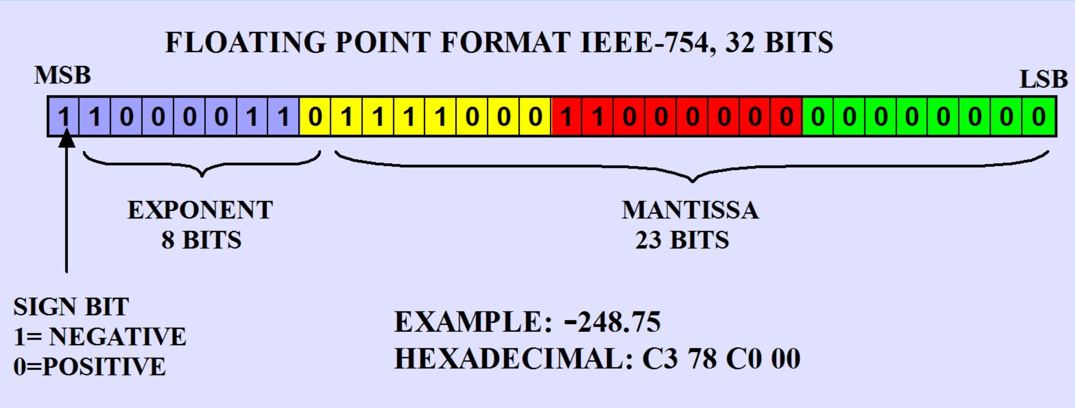
IEEE-754 Floating Point Standard
Format | Mantissa bits (stored) | Significand precision (with implicit 1) | Exponent bits
FP16 (half) | 10 | 11 | 5
FP32 (single) | 23 | 24 | 8
FP64 (double) | 52 | 53 | 11

Slide 32
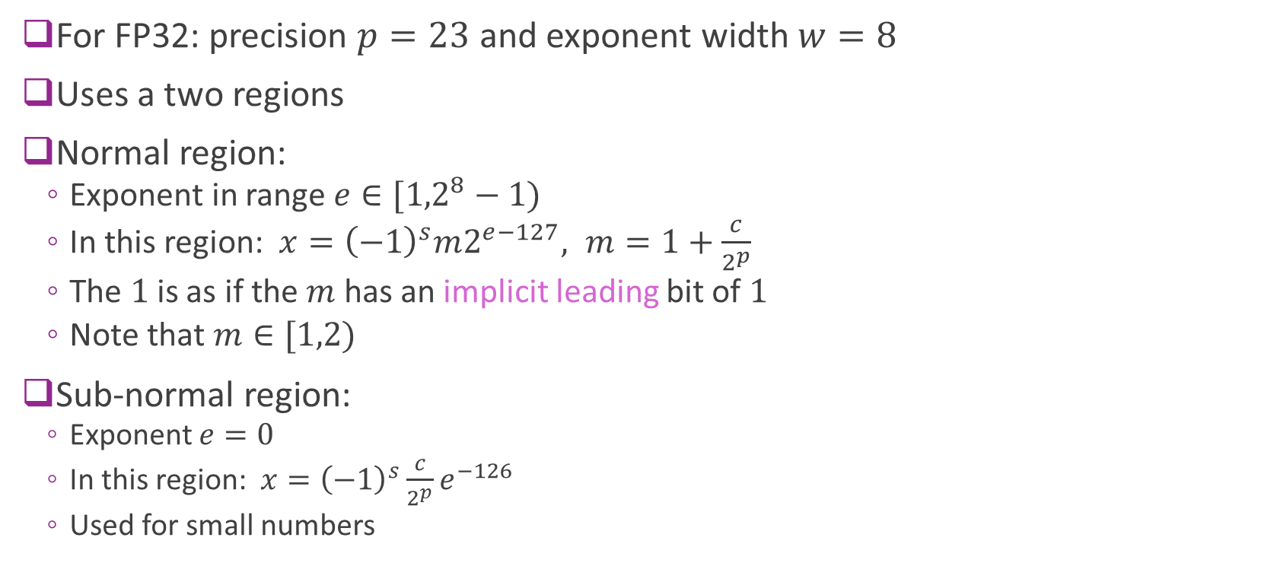
IEEE 754 Normal and Sub-Normal
For FP32: precision $p=23$ and exponent width $w=8$
Uses a two regions
Normal region:
Exponent in range $e∈[{1,2}^{8}−1)$
In this region: $x={\left(−1\right)}^{s}m2^{e−127}, m=1+\frac{c}{2^{p}}$
The $1$is as if the $m$ has an implicit leading bit of $1$
Note that $m∈[1,2)$
Sub-normal region:
Exponent $e=0$
In this region: $x={\left(−1\right)}^{s}\frac{c}{2^{p}}e^{−126}$
Used for small numbers

Slide 33
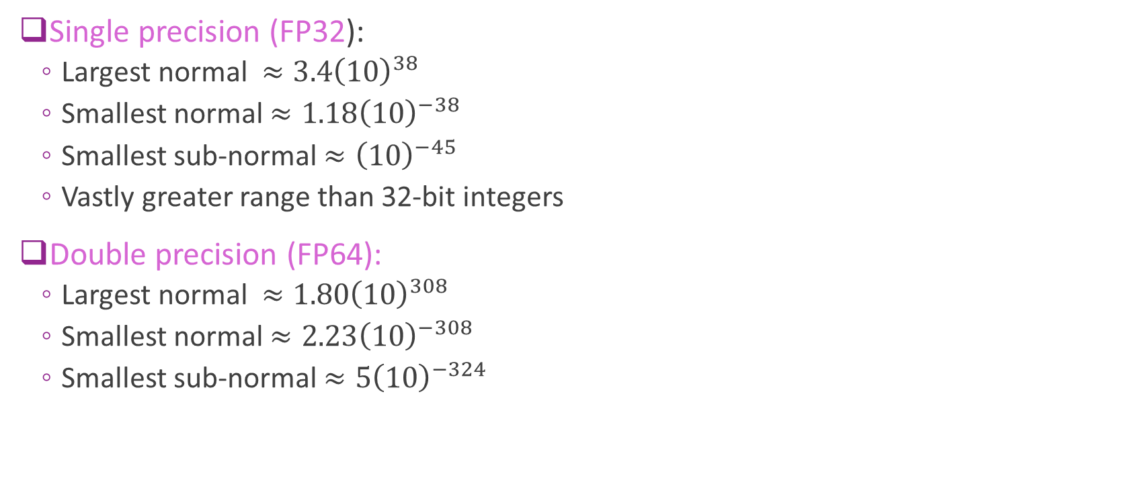
IEEE 754 Properties
Single precision (FP32):
Largest normal $≈3.4{\left(10\right)}^{38}$
Smallest normal $≈1.18{\left(10\right)}^{−38}$
Smallest sub-normal $≈{\left(10\right)}^{−45}$
Vastly greater range than 32-bit integers
Double precision (FP64):
Largest normal $≈1.80{\left(10\right)}^{308}$
Smallest normal $≈2.23{\left(10\right)}^{−308}$
Smallest sub-normal $≈{5\left(10\right)}^{−324}$

Slide 34
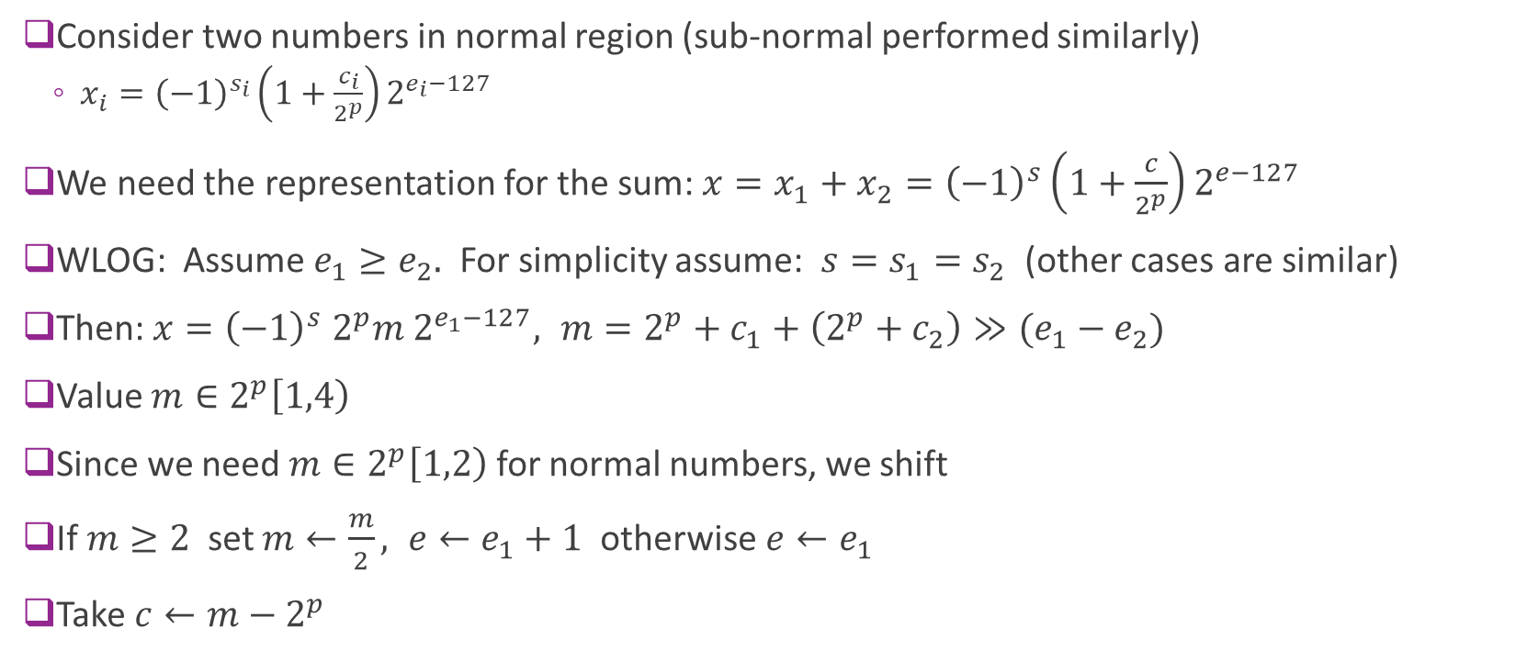
Floating Point Addition
Consider two numbers in normal region (sub-normal performed similarly)
$x_{i}={\left(−1\right)}^{s_{i}}\left(1+\frac{c_{i}}{2^{p}}\right)2^{e_{i}−127}$
We need the representation for the sum: $x=x_{1}+x_{2}={\left(−1\right)}^{s}\left(1+\frac{c}{2^{p}}\right)2^{e−127}$
WLOG: Assume $e_{1}≥e_{2}.$ For simplicity assume: $s=s_{1}=s_{2}$ (other cases are similar)
Then: $x={\left(−1\right)}^{s} 2^{p}m 2^{e_{1}−127}, m=2^{p}+c_{1}+\left(2^{p}+c_{2}\right)≫(e_{1}−e_{2})$
Value $m∈2^{p}\left[1,4\right)$
Since we need $m∈2^{p}\left[1,2\right)$ for normal numbers, we shift
If $m≥2$ set $m←\frac{m}{2}, e←e_{1}+1$ otherwise $e←e_{1}$
Take $c←m−2^{p}$

Slide 35
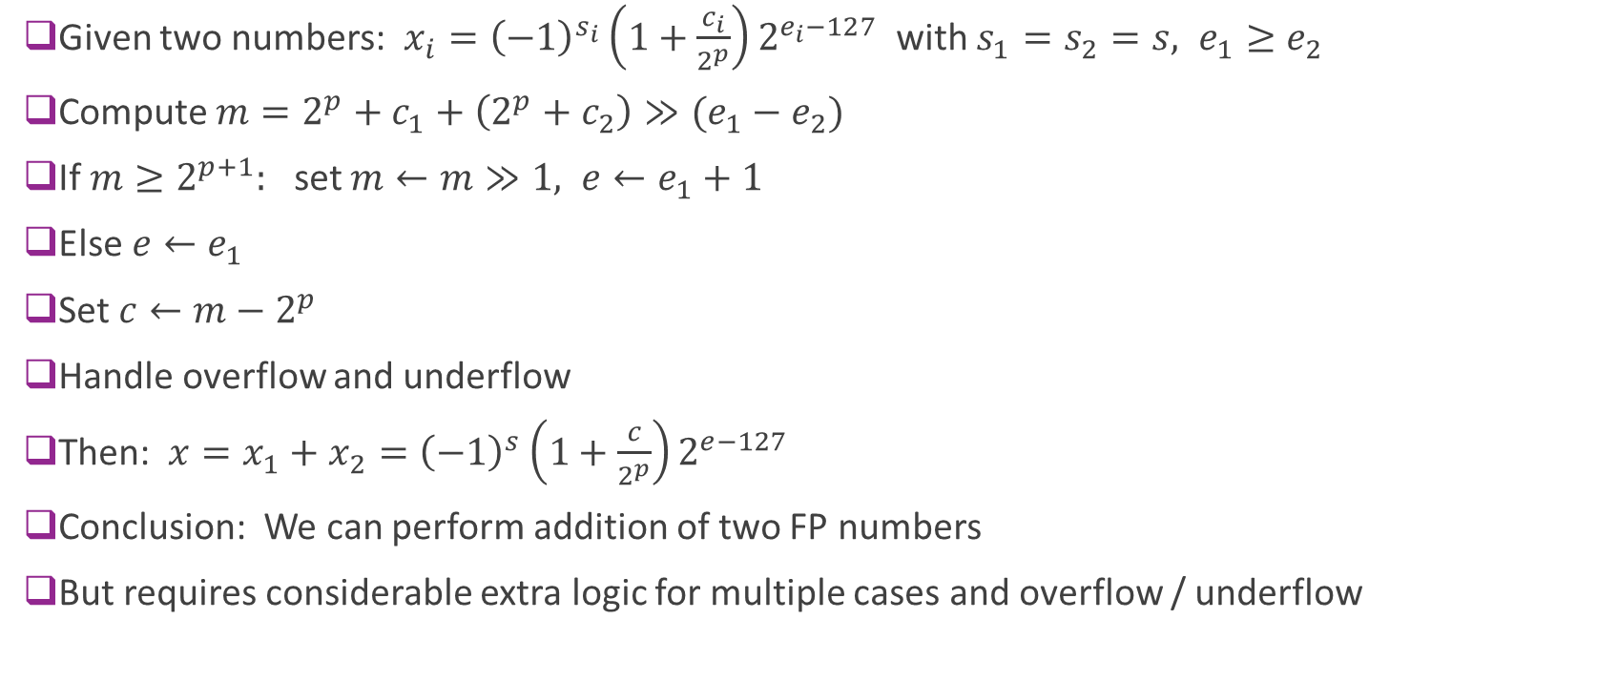
Resulting Algorithm
Given two numbers: $x_{i}={\left(−1\right)}^{s_{i}}\left(1+\frac{c_{i}}{2^{p}}\right)2^{e_{i}−127}$ with $s_{1}=s_{2}=s, e_{1}≥e_{2}$
Compute $m=2^{p}+c_{1}+\left(2^{p}+c_{2}\right)≫(e_{1}−e_{2})$
If $m≥2^{p+1}:$ set $m←m≫1, e←e_{1}+1$
Else $e←e_{1}$
Set $c←m−2^{p}$
Handle overflow and underflow
Then: $x=x_{1}+x_{2}={\left(−1\right)}^{s}\left(1+\frac{c}{2^{p}}\right)2^{e−127}$
Conclusion: We can perform addition of two FP numbers
But requires considerable extra logic for multiple cases and overflow / underflow

Slide 36
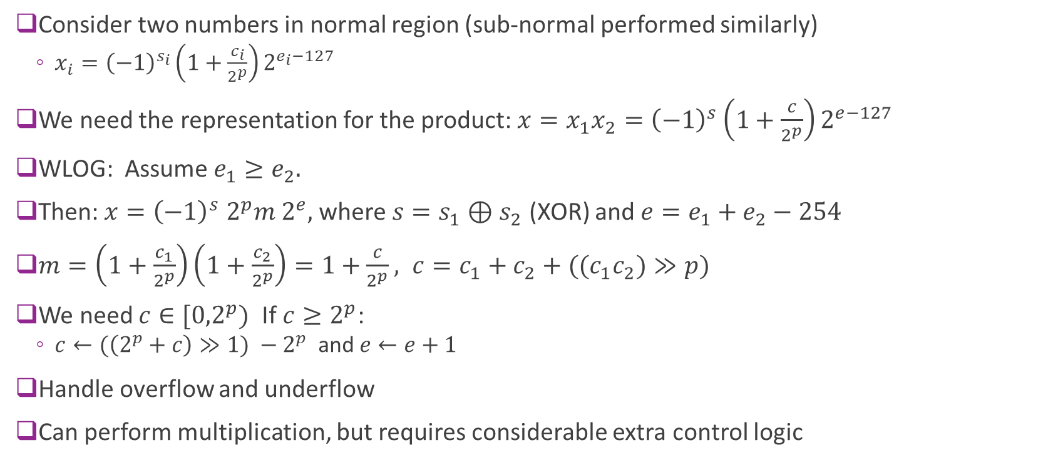
Floating Point Multiplication
Consider two numbers in normal region (sub-normal performed similarly)
$x_{i}={\left(−1\right)}^{s_{i}}\left(1+\frac{c_{i}}{2^{p}}\right)2^{e_{i}−127}$
We need the representation for the product: $x=x_{1}x_{2}={\left(−1\right)}^{s}\left(1+\frac{c}{2^{p}}\right)2^{e−127}$
WLOG: Assume $e_{1}≥e_{2}.$
Then: $x={\left(−1\right)}^{s} 2^{p}m 2^{e},$where $s=s_{1}⊕s_{2}$ (XOR) and $e=e_{1}+e_{2}−254$
$m=\left(1+\frac{c_{1}}{2^{p}}\right)\left(1+\frac{c_{2}}{2^{p}}\right)=1+\frac{c}{2^{p}}, c=c_{1}+c_{2}+((c_{1}c_{2})≫p)$
We need $c∈[{0,2}^{p})$ If $c≥2^{p}$:
$c←(\left(2^{p}+c\right)≫1) −2^{p}$ and $e←e+1$
Handle overflow and underflow
Can perform multiplication, but requires considerable extra control logic

Slide 37
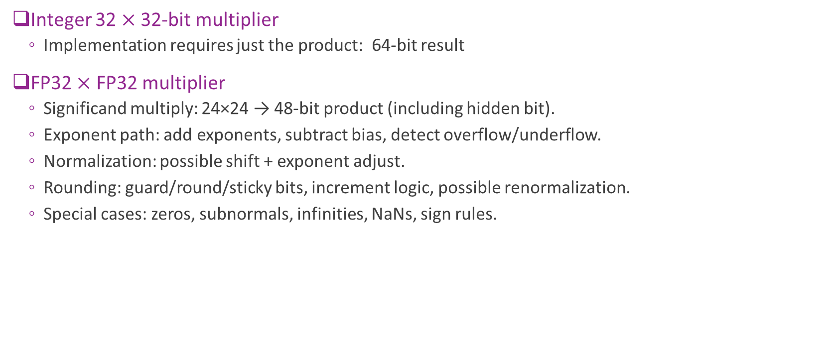
Comparison
Integer 32 $×$ 32-bit multiplier
Implementation requires just the product: 64-bit result
FP32 $×$ FP32 multiplier
Significand multiply: 24×24 → 48‑bit product (including hidden bit).
Exponent path: add exponents, subtract bias, detect overflow/underflow.
Normalization: possible shift + exponent adjust.
Rounding: guard/round/sticky bits, increment logic, possible renormalization.
Special cases: zeros, subnormals, infinities, NaNs, sign rules.
FP multiplication typically takes 2 to 4 $×$ complexity

Slide 38
Outline
Integers, Truncation, and Overflows
Floating Point Numbers
Fixed Point Numbers
Mapping Floating to Fixed Point in Python
System Verilog Implementation

Slide 39
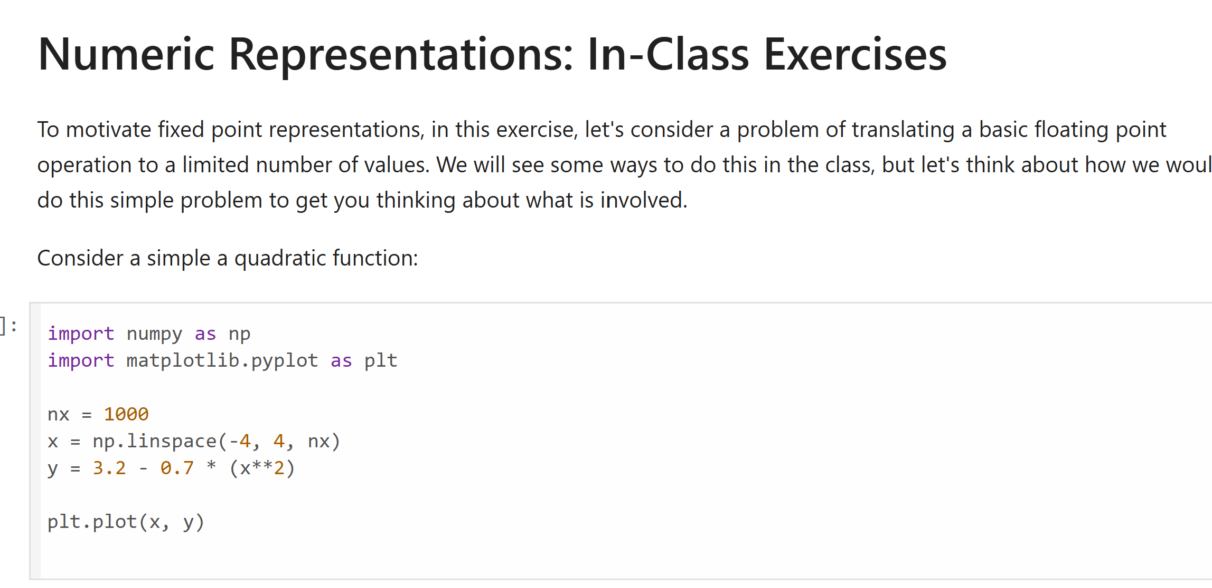
Motivating In-Class Exercise
Try the following jupyter notebook

Slide 40
Integers vs. Floating Point
Integers:
Pro: Easy arithmetic. No extra bits for exponent
Cons: Do not natively handle fractional components.
Cons: Limited dynamic range
Floating point:
Pro: Large dynamic range, handles fractional components
Cons: Arithmetic is harder, some loss of precision to store exponent
Is there a way to handle fractions without increased computation overhead?

Slide 41
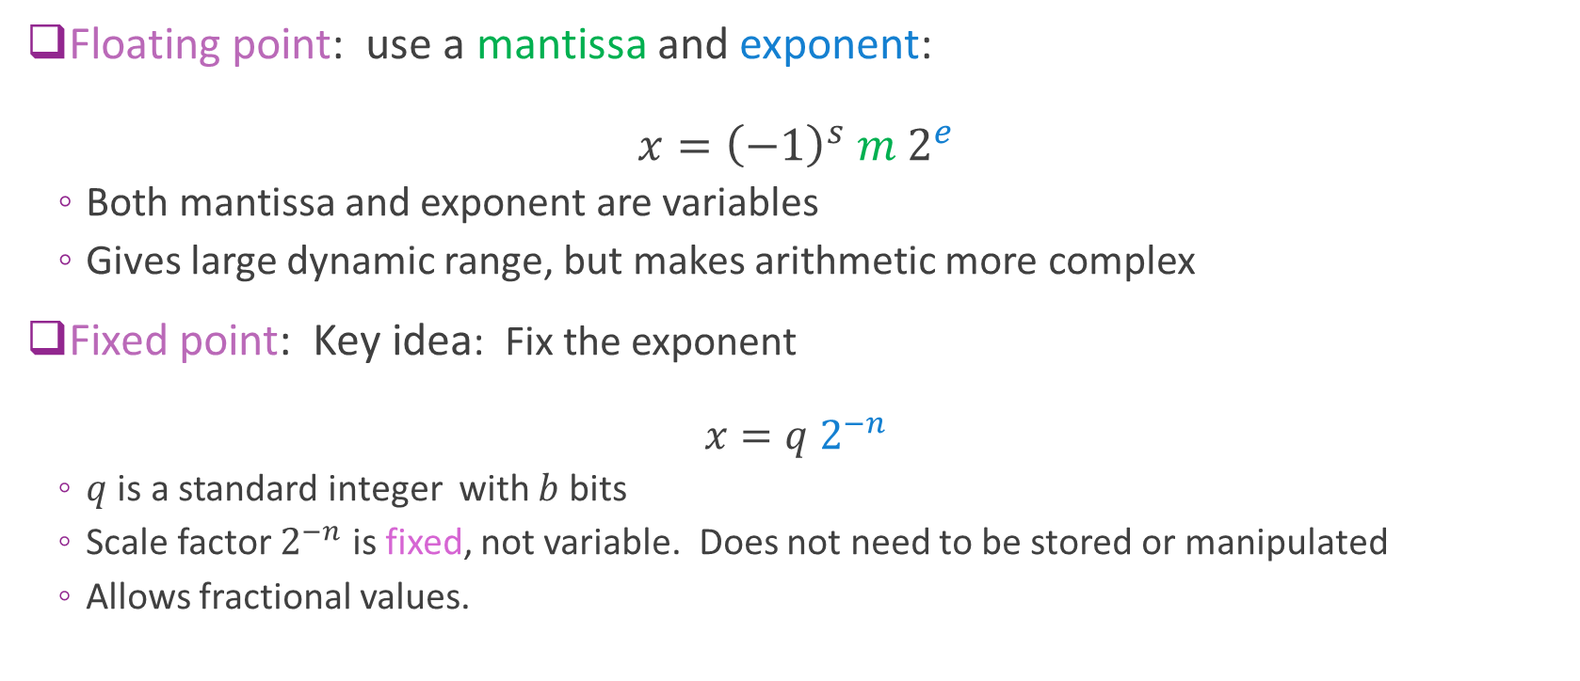
Fixed Point
Floating point: use a mantissa and exponent: $x={\left(−1\right)}^{s} m 2^{e}$
Both mantissa and exponent are variables
Gives large dynamic range, but makes arithmetic more complex
Fixed point: Key idea: Fix the exponent $x=q 2^{−n}$
$q$ is a standard integer with $b$ bits
Scale factor $2^{−n}$ is fixed, not variable. Does not need to be stored or manipulated
Allows fractional values.

Slide 42
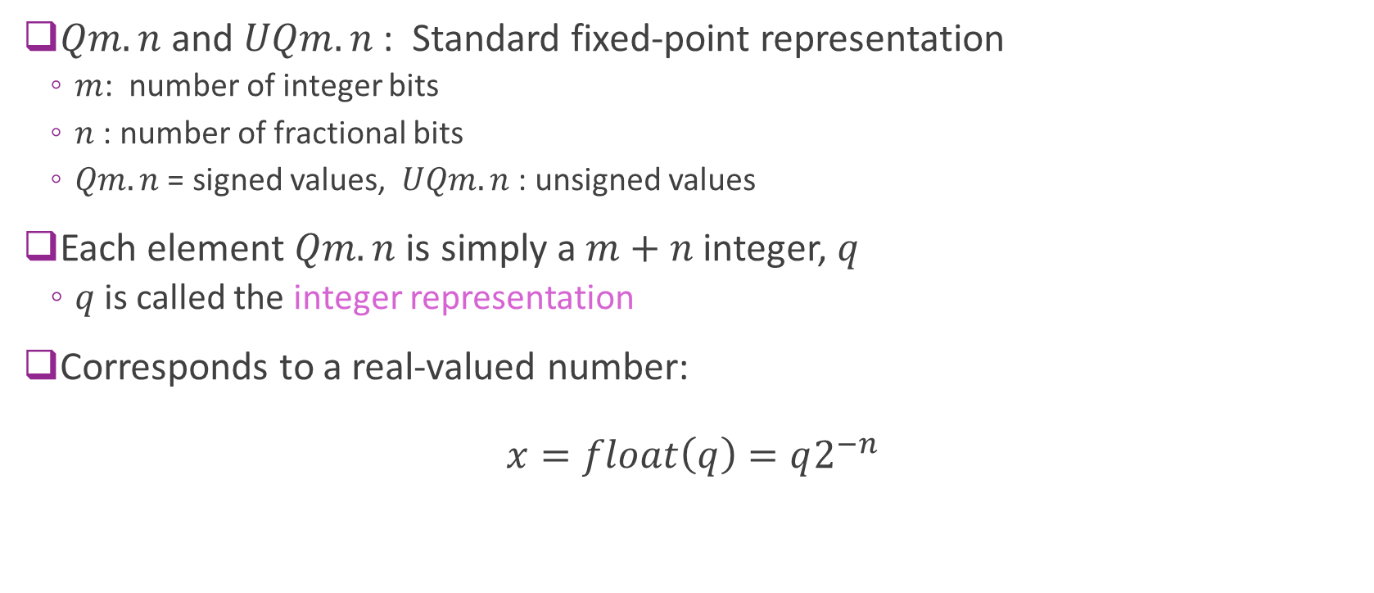
Fixed Point Q Notation
$Qm.n$ and $UQm.n$ : Standard fixed-point representation
$m$: number of integer bits
$n$ : number of fractional bits
$Qm.n$ = signed values, $UQm.n$: unsigned values
Each element $Qm.n$ is simply a $m+n$ integer, $q$
$q$ is called the integer representation
Corresponds to a real-valued number: $x=float\left(q\right)=q2^{−n}$

Slide 43
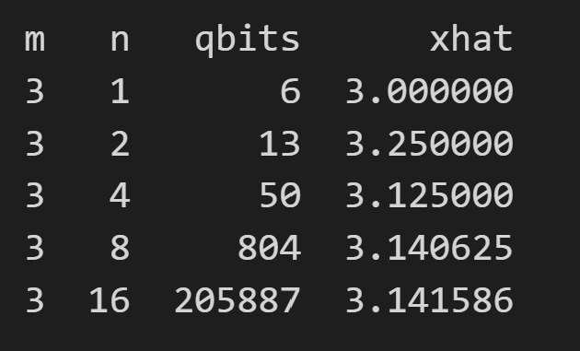

Examples
Take $x_{0}=π$
Find closest approximation with:
$m=3$ and $n$ varies
Table shows:
$q$ value (qbits): integer representation
Floating point value: $\hat{x}=q2^{−n}$
We see as $n$ increases:
More accurate representation

Slide 44

Properties
Suppose that $q∈UQm.n$ or
Total number of bits $b=m+n$
Range:
$q∈Qm.n⇒ x∈\left[−2^{m−1},2^{m−1}\right)$
$q∈UQm.n⇒x∈[0, 2^{m})$
Resolution: Minimum positive number: $2^{−n}$
Dynamic range:
$Qm.n$ : $D= \log_{2}\left(\frac{2^{m−1}}{2^{−n}}\right)=m+n−1=b−1$ bits
$Um.n$ : $D= \log_{2}\left(\frac{2^{m}}{2^{−n}}\right)=m+n=b$ bits

Slide 45

Arithmetic Operations
Suppose that $q_{1}$ and $q_{2}$ are $Qm.n$ bit representations of $x_{1}=q_{1}2^{−n}$ and $x_{2}=q_{2}2^{−n}$
Assume they are the same parameters $m$ and $n$ for now
Addition:
$x=x_{1}+x_{2}=2^{n}\left(q_{1}+q_{2}\right)=2^{n}$ with $q=q_{1}+q_{2}$
Addition of numeric values = Addition of the integer representations
Multiplication:
$x=x_{1}x_{2}=2^{2n}q_{1}q_{2}=2^{n}q$ with $q=q_{1}q_{2}≫n$
Multiplication of the numerical values = multiplication of integer values with $≫n$
Same overflow rules as integers

Slide 46

Example Problem

Slide 47

Solution

Slide 48

Type Casting
Suppose that $q_{0}$ in the bit representation in $Qm_{0}.n_{0}$.
We want to convert to $q_{1}=Qm_{1}.n_{1}$
Since $x=q_{0}2^{{−n}_{0}}=\left(q_{0}2^{n_{1}−n_{0}}\right)2^{−n_{1}}=q_{1}2^{−n_{1}}$ where $q_{1}=q_{0}2^{n_{1}−n_{0}}$
Implementable with left shift by $n_{1}−n_{0}$ or right shift by $n_{0}−n_{1}$
For $q_{1}≥0,$ will overflow when $q_{1}≥2^{m_{1}+n_{1}−1}$
Overflow can only occur when $m_{1}<m_{0}$:
Why? Suppose $m_{1}≥m_{0}$
Since $q_{0}≤2^{m_{0}+n_{0}−1}, q_{1}=q_{0}2^{n_{1}−n_{0}}≤2^{m_{0}+n_{1}−1 }≤2^{m_{1}+n_{1}−1}⇒$ No overflow
However changing $n_{1}$ or $n_{0}$ may change precision

Slide 49

Comparison
Property | 32-bit integer $I(32)$ | 32-bit floating point FP32 | $\text{32−}\text{bit} \text{fixed} \text{point}$ $Qm.n,$ $m+n=32$
Complexity | Easy | Moderately hard | Easy
Can handle fractional values | No | Yes | Yes
Dynamic range | Low | High | Low

Slide 50
Outline
Integers, Truncation, and Overflows
Floating Point Numbers
Fixed Point Numbers
Optimal Scaling of FixP Numbers
Converting Floating Point Algorithms to Fixed Point

Slide 51

Selecting the Precision
Suppose we have a real-valued number $x$
Want to represent as $q$ in $Qm.n$
How do we select $m$ and $n$?
Total width $W=m+n$ determined by storage and complexity
For a fixed width $W$ we can vary $n$
How do we select $n$ ?

Slide 52


Probabilistic Analysis
Let $X=$ variable to quantize
Model $X$ as a random variable
The HW will see different values over time
Example to right: $X\sim N(0,1)$
Blue = PDF of $X$
Fixed $W=m+n$ = total bitwidth
Red lines = Qunatization bins for $Qm.n$
Selecting $n$
Tradeoff of overflow and precision
More integer bits
More fractional bits
Minimal overflow Low precision
High overflow High precision

Slide 53






Encoding, Representation, and Decoding
Encode
Representation
Decode
Real value
Quantized
Real value
$$x$$
$$\hat{x}$$
Ex: $Qm.n(⋅)$
$$q$$
$\hat{Q}m.n(⋅)$
Analyze any number class with three components: Encode, representation, decoding
For fixed-point, we use the notation:
$q=Qm.n(x)$ : Encodes a real number $x$ to an integer representation $q$
$\hat{x}=\hat{Q}m.n(q)$ : Decodes an integer representation back to a real number

Slide 54




Mean Squared Error
Consider some encoding and decoding:
$q=Qm.n(x)$ and $\hat{x}=\hat{Q}m.n(q)$
Suppose that real value can be modeled probabilistically
Has a probability density function $p(x)$
Then we can measure the mean squared error: $MSE=𝔼\left( {\left(x−\hat{x}\right)}^{2}\right)=\int{p(x){\left(x−\hat{x}\right)}^{2}}dx$
Measures the average error
Includes error to both precision and overflow
We can then select $n$ to minimize MSE
Assumes we have a PDF of $X$
That is, we know what values we are expecting
$$x$$
$$\hat{x}$$
$$q$$

Slide 55



Optimal Selection of $n$
Example to the left: $X \sim N(0,1)$
For each $W$ we try different $N$
Initially MSE decreases with $N$
Higher precision
But then MSE increases
Overflow
Optimal value is a few bits below $W$

Slide 56
Outline
Integers, Truncation, and Overflows
Floating Point Numbers
Fixed Point Numbers
Optimal Scaling of Fix Point Numbers
Converting Floating Point Algorithms to Fixed Point

